Slide 1
EMULSIFICATION
Emulsion is a dispersion of one phase into the other in the form of fine droplets
Oil-in water or Water-in-oil emulsions
Many food products are emulsions
Examples of oil-in-water emulsions are: salad dressing, mayonnaise, ice cream mix
Examples of water-in-oil emulsions are: butter, margarine
Meat emulsion is fat dispersed in an aqueous medium of very high salt and meat protein concentrations.

Slide 2
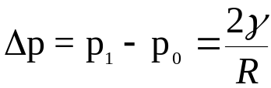

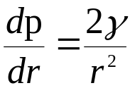
EMULSIFICATION
Laplace equation:
p₀
p₁
Deformation leads to smaller radius of
curvature and hence larger pressure
difference.
For breakup of a spherical droplet of radius
R, the pressure gradient dp/dr needed is given by
Drop of radius R
r
r < R
    Deformed drop

Slide 3
EMULSIFICATION
Food emulsifiers (surfactants, proteins) are added to facilitate emulsion formation through the reduction of the interfacial tension-reduces the pressure gradient required for drop breakup
Boncroft rule: the phase in which the surfactant is soluble is usually the continuous phase-drops of the phase in which surfactant is soluble will coalesce since the continuous phase will not have surfactant to stabilize the drops

Slide 4
EMULSIFICATION
Droplets can be deformed and disrupted by viscous or inertial forces
Viscous forces- generate tangential and normal stresses at the drop interface
Inertial forces- generate pressure differences at the drop interface

Slide 5
EMULSIFICATION
Laminar flow- causes shear or elongation of the droplet
Turbulent flow- causes random deformation of the droplet due to pressure fluctuation
Cavitation- collapse of small vapor bubbles cause shock waves causing intense agitation

Slide 6
EVALUATION OF EMULSIFICATION
Emulsion capacity- Maximum amount of dispersed phase (oil or water) that can be emulsified ( measure of surfactant to form emulsion)
Emulsion stability
  heat stability: stability for brownian flocculation
  centrifugal stability: stability for creaming
  measure of surfactant to provide shelf life to emulsion
Drop size
  turbidity: surface area per unit volume
  drop size distribution

Slide 7
Emulsion Breakdown Mechanisms
Phase
Separation
Creaming/ Sedimentation
Coalescence
Flocculation
Coagulation

Slide 8

COLLOID MILL
stator
stator
rotor
rotor
stator
shear flow
rotor

Slide 9
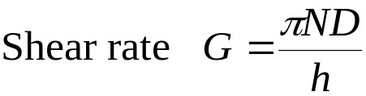
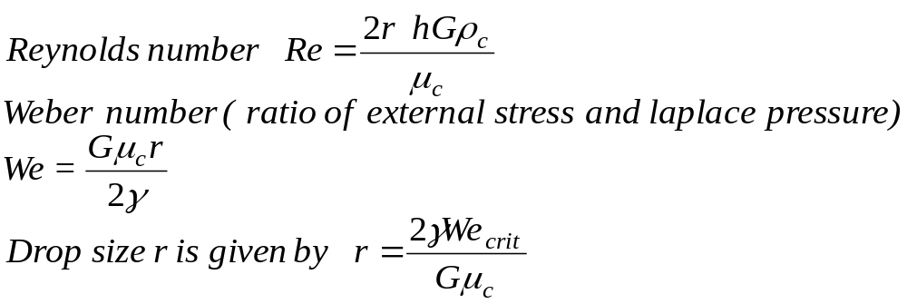
COLLOID MILL
stator
simple shear
h
rotor
Important dimensionless groups are:

Slide 10


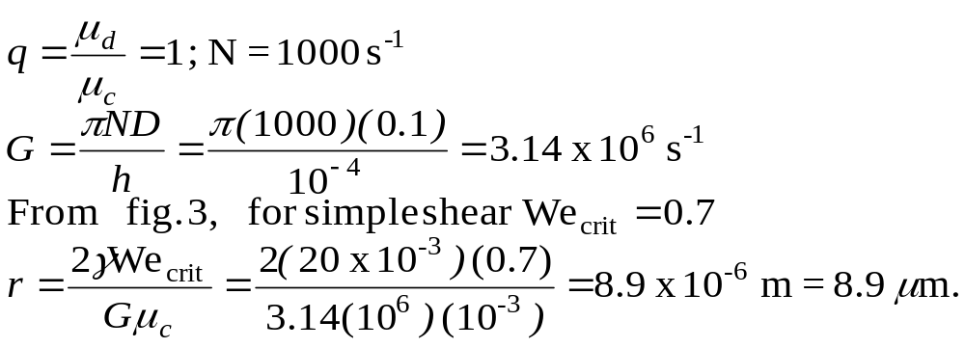
COLLOID MILL
Example: Vegetable oil ( of viscosity 1cp) is to be emulsified in water (with
emulsifiers and proteins) using a colloid mill. D = 0.1 m. h = 100 ,
N = 60,000 rpm. = 20 mN/m. Calculate the mean drop size of the emulsion.
Solution:

Slide 11
Schematic of a homogenizer valve
In
h
Side View
Out
Valve seat
R₁
Top View
R₂

Slide 12

TURBULENT FLOW
Velocity in a turbulent flow exhibits random fluctuations
The deviation from the average velocity is characterized by root-mean-square average defined as

Slide 13
TURBULENT FLOW
The velocity fluctuation can be expressed as a superposition
of periodic disturbances of different wavelengths (frequencies)
Each wavelength (frequency) corresponds to an eddy of certain
size
Turbulent energy is transported from large eddies to smaller
eddies
Larger eddies mainly convect the turbulent energy to smaller
eddies
Smaller eddies dissipate energy due to viscous dissipation

Slide 14

TURBULENT FLOW
Convection
Inertial
subrange
Viscous
subrange
E(k)
Large
eddies
Small
eddies
wave number k

Slide 15
TURBULENT FLOW
Eventhough the flow is not usually isotropic, for sufficiently large Reynolds numbers, the flow over smaller length scales is locally isotropic
Inertial subrange- range of eddy sizes for which the flow is locally isotropic and viscous dissipation is not important
Viscous subrange- range of eddy sizes for which the flow is locally isotropic and viscous dissipation is important

Slide 16
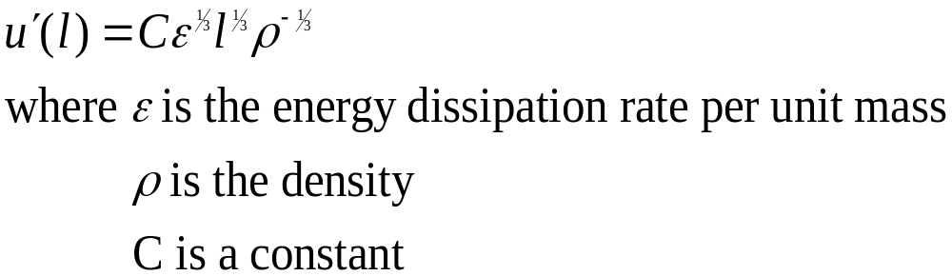
TURBULENT FLOW
Inertial subrange:
The root mean square velocity between 2 points distance l apart is

Slide 17
DROPLET BREAKUP
Drop subjected
to pressure
fluctuations
Deformed droplet
Daughter drops after
fragmentation
Critical Weber number for drop breakage is one.

Slide 18
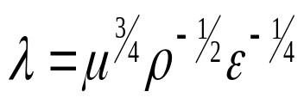
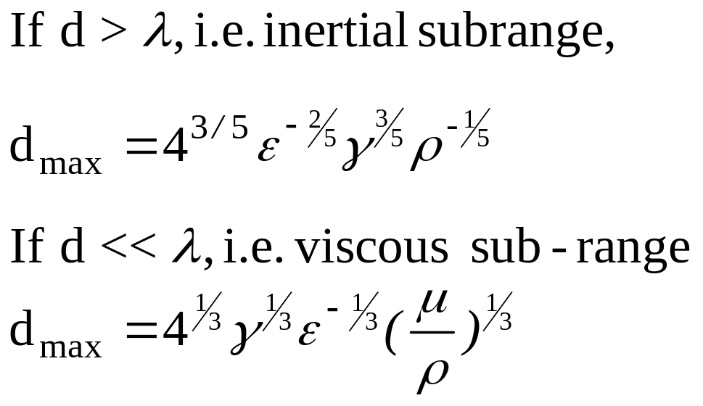
DROPLET BREAKUP
Microscale of turbulence

Slide 19
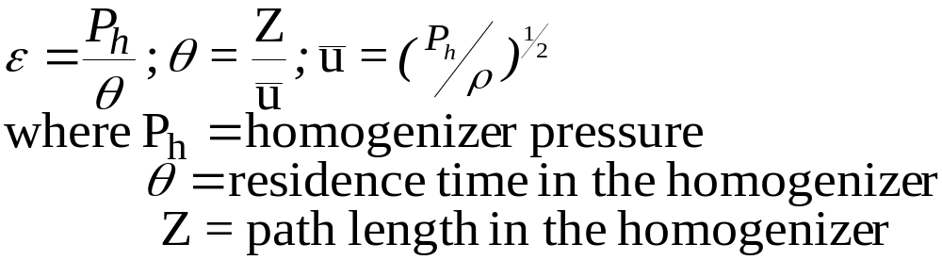
HOMOGENIZER
For a high pressure homogenizer,

